Slide 1
COSC 1209
- AWS CloudFormation

Slide 2
AWS CloudFormation
Speed up cloud provisioning with infrastructure as code
IaC (Infrastructure as Code)

Slide 3
Declarative vs Imperative Infrastructure as Code
There are two main approaches for writing IaC code:
Declarative
Imperative
Declarative IaC
A declarative approach to IaC is one in which the user defines the future state and lists all resources and attributes within the infrastructure; however, the tool or platform will determine how to best install and configure the system to achieve the future state.
Imperative IaC
An imperative approach requires far more input and specificity than a declarative approach. In this method, the developer or IT team will define the future state and also specify the process for doing so. The tool or system will not deviate from the steps within the process or change the order.

Slide 4
Agenda
Getting Started with AWS CloudFormation Service
Understand Key Terminologies
Demo

Slide 5
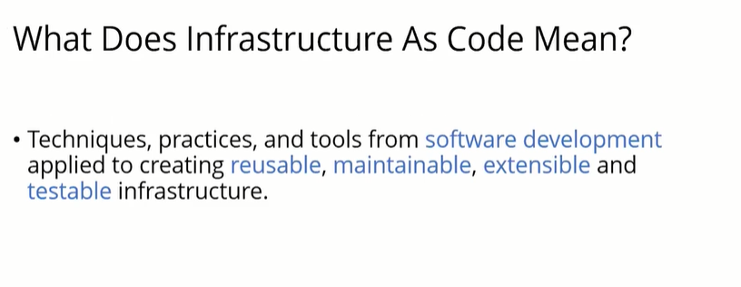

Slide 6
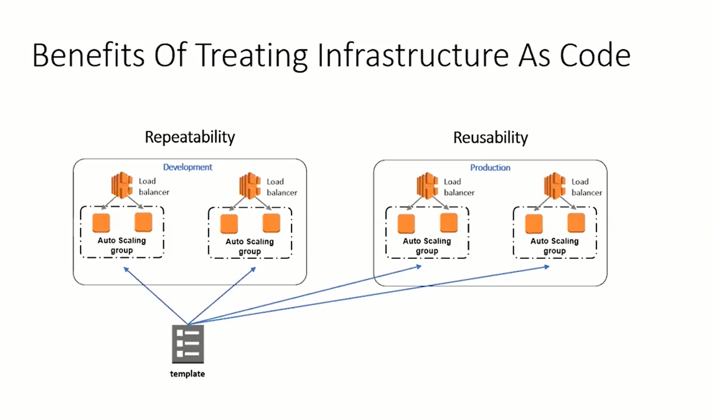

Slide 7
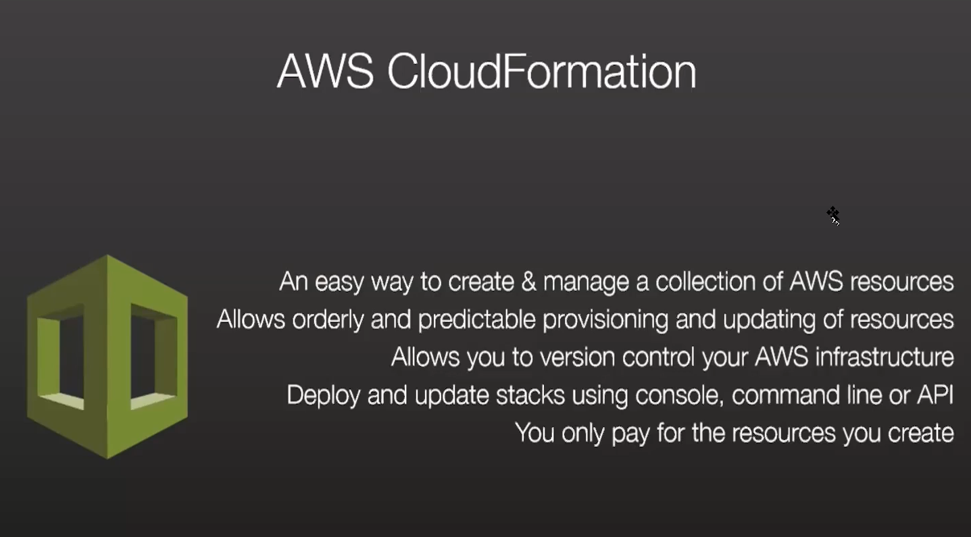

Slide 8
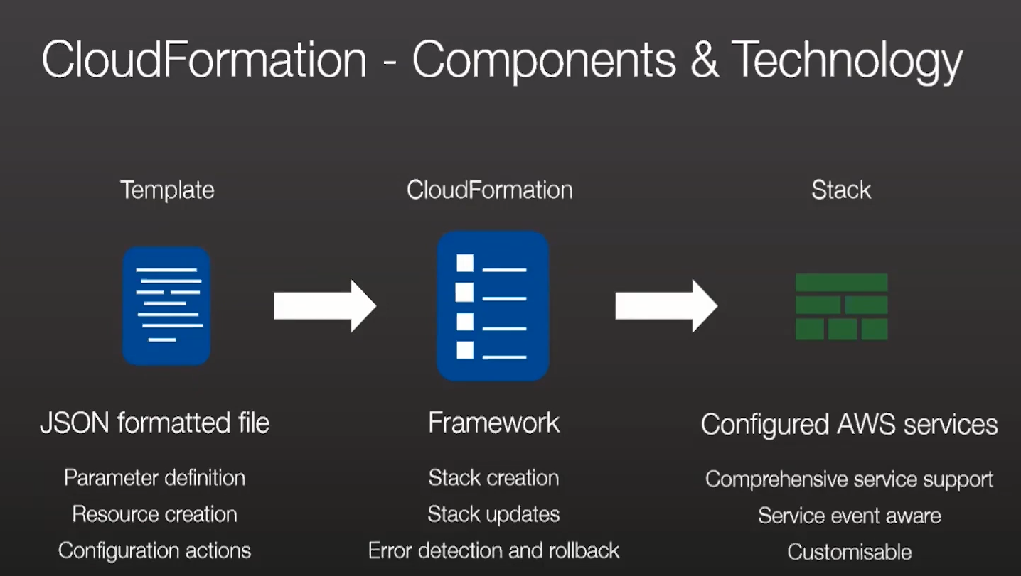

Slide 9
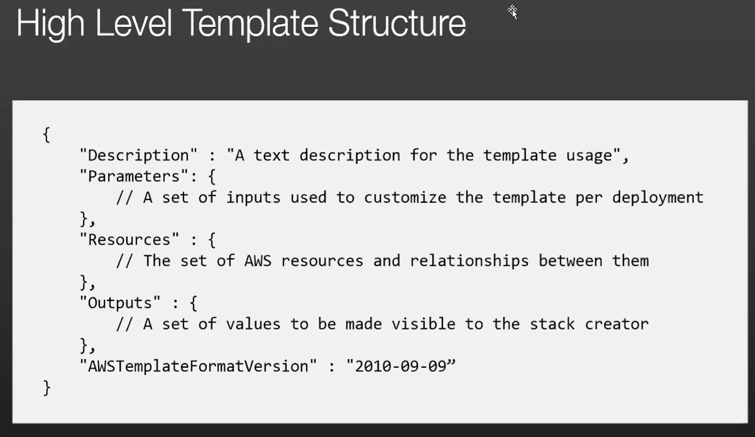

Slide 10
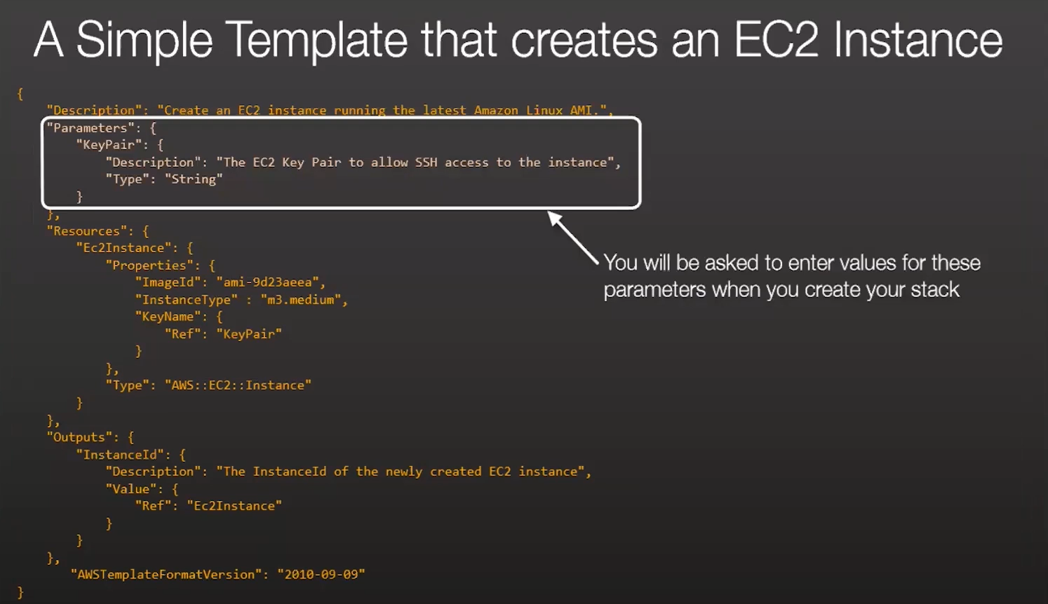

Slide 11
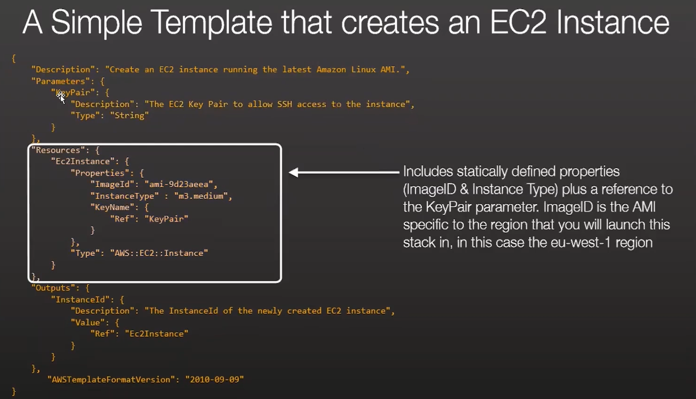

Slide 12
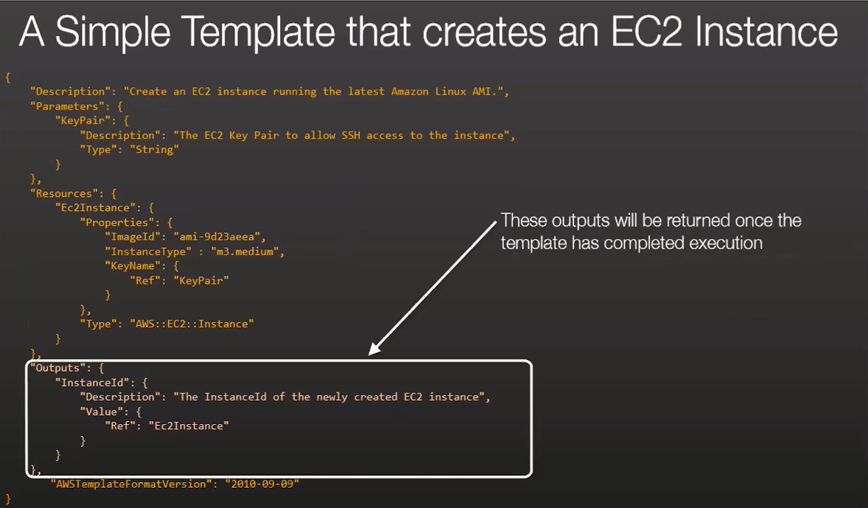

Slide 13
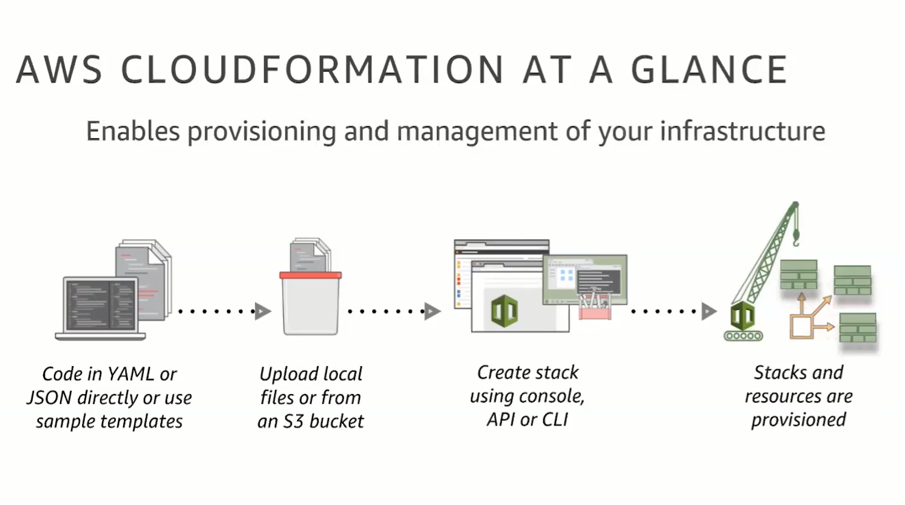

Slide 14
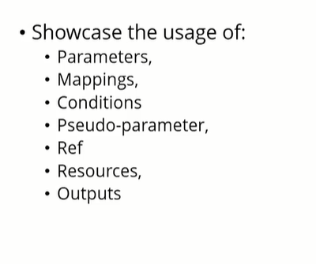

Slide 15
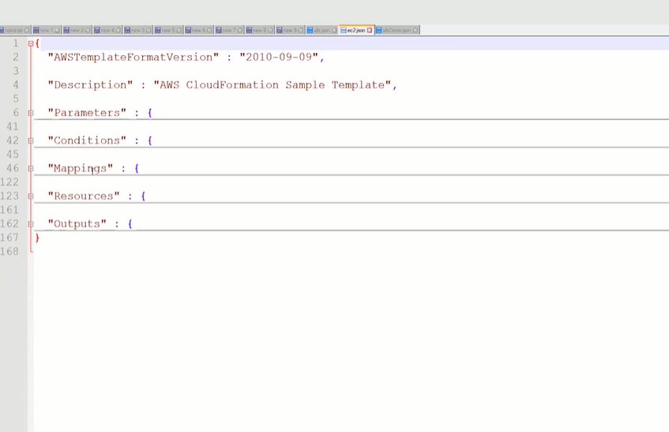

Slide 16
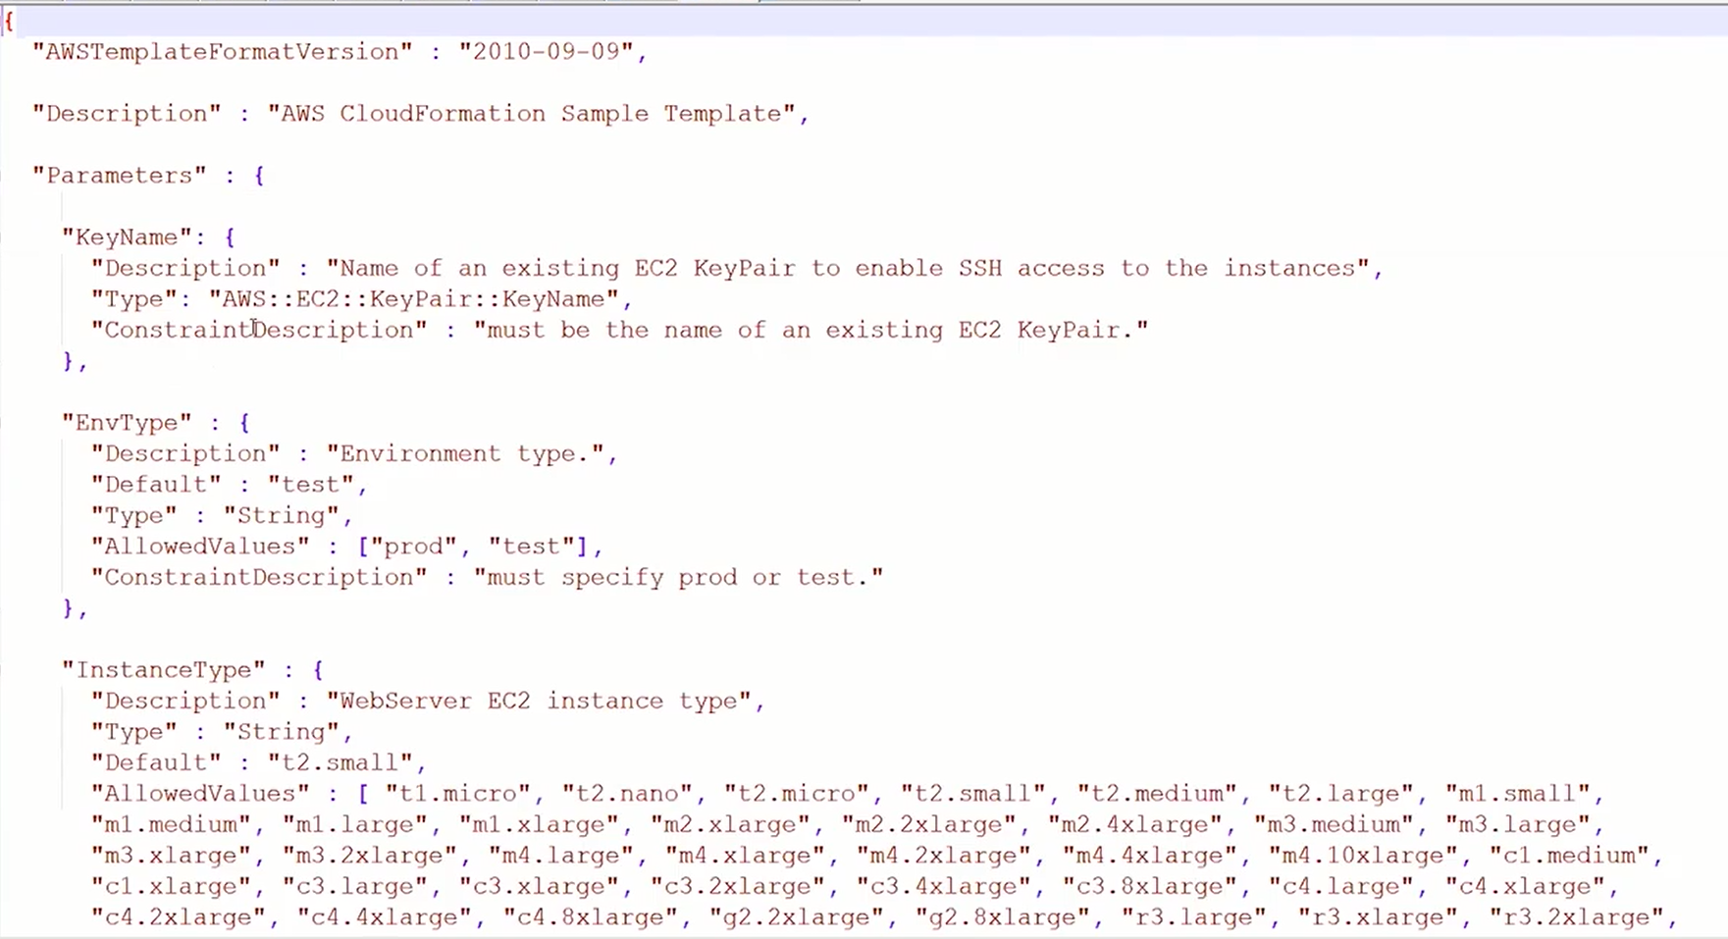
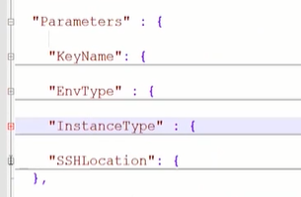
Parameters

Slide 17
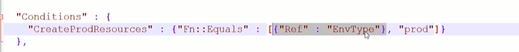
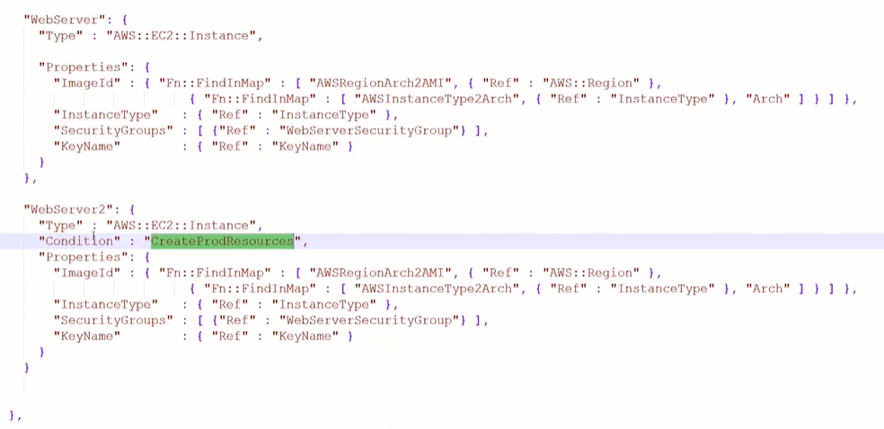
Conditions

Slide 18
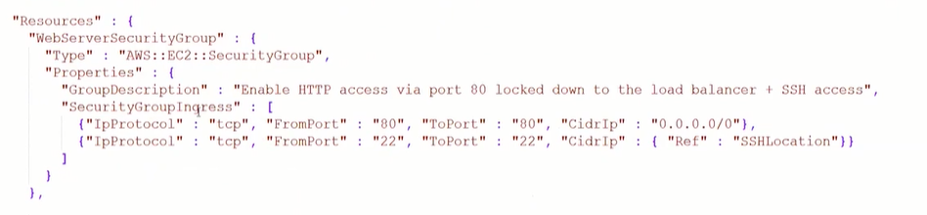
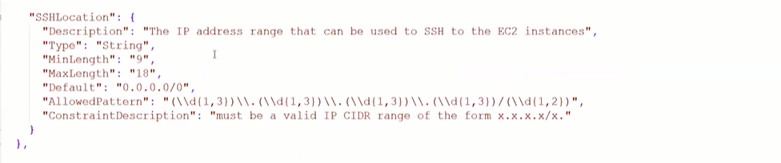
Resources

Slide 19
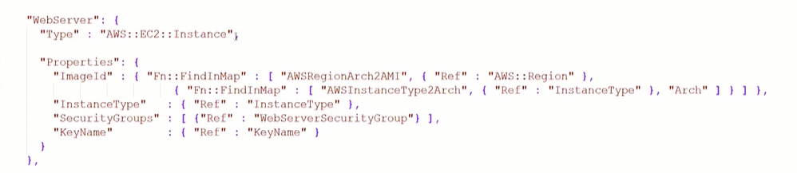
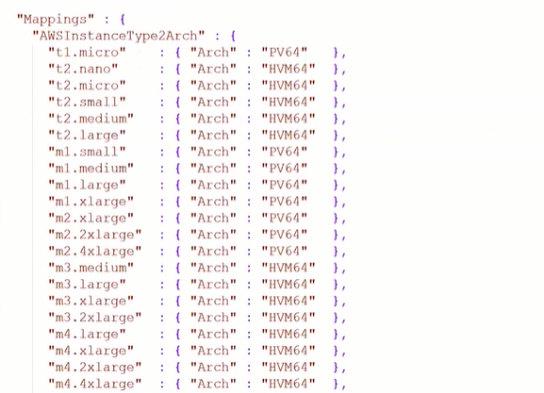
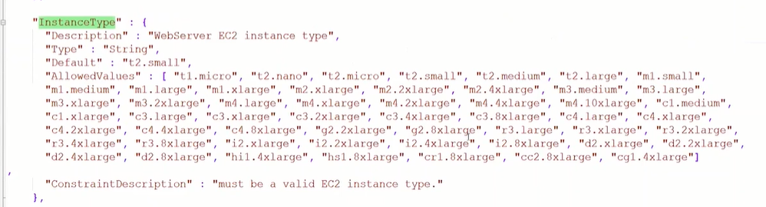
Mappings

Slide 20
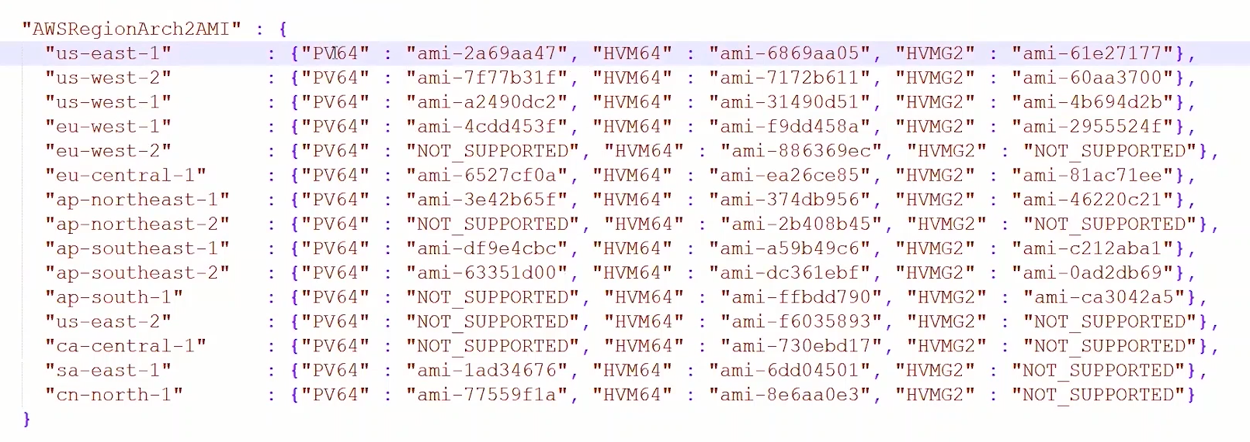

Slide 21
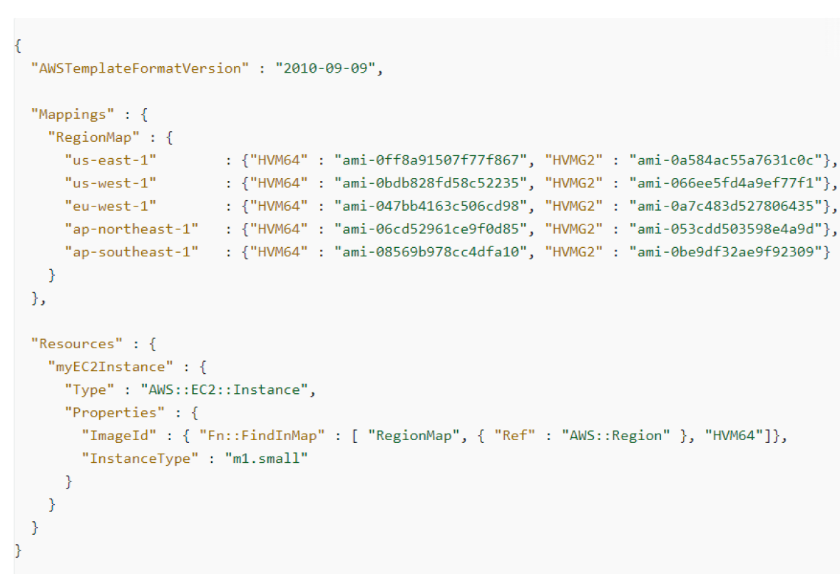

Slide 22
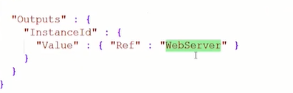
Outputs

Slide 23


Slide 24
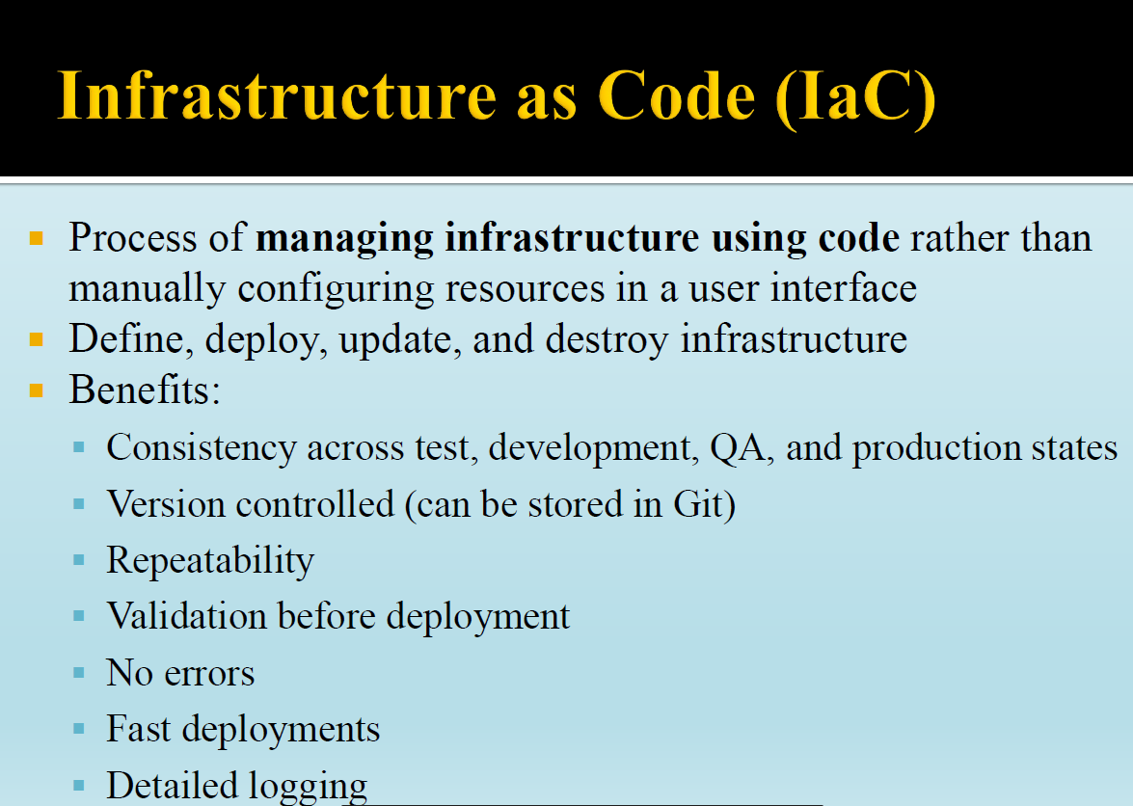

Slide 25
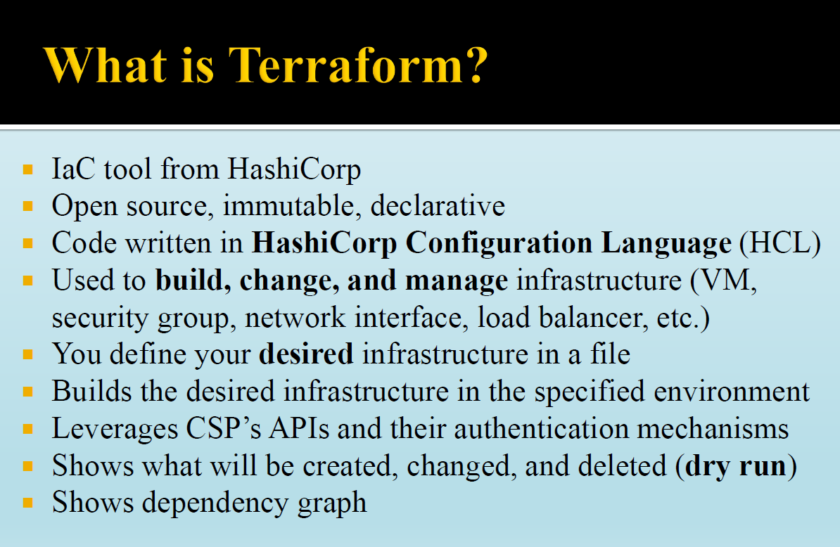

Slide 26
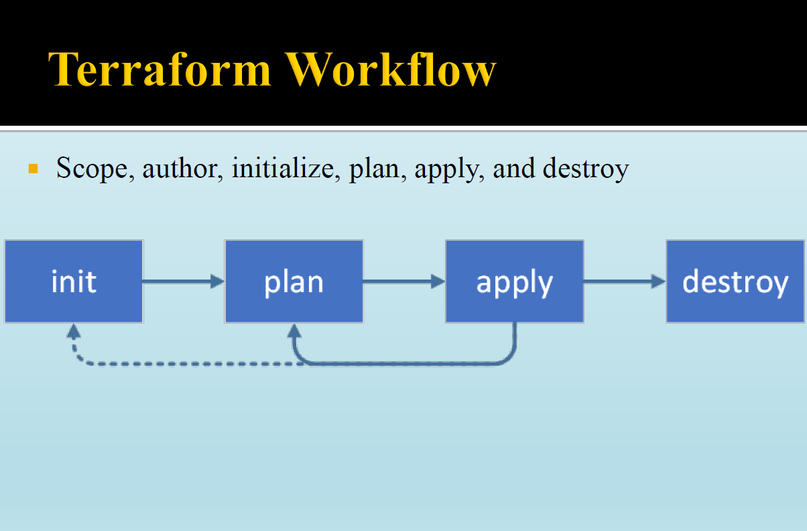

Slide 27
Practice

Slide 28
CloudFormation Template for VPC with EC2 and ALB – 10 Marks
You must show target groups are showing healthy – 5 Marks
Application is accessible through LB – 5 Marks (application is the userdata under the final.json file) – 5 Marks

Slide 29
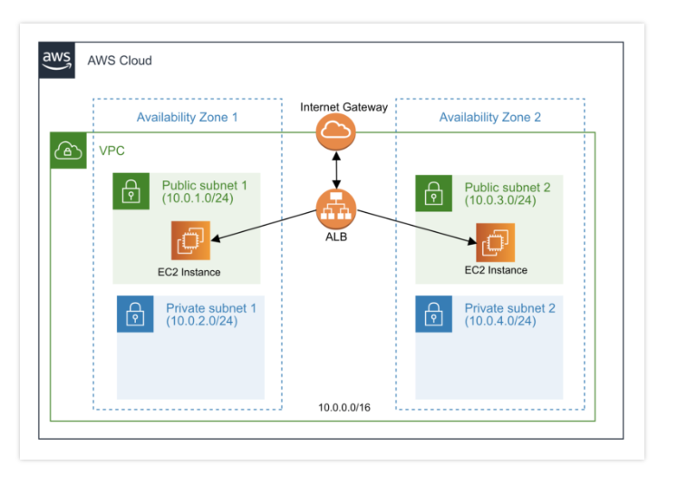
Design

Slide 30
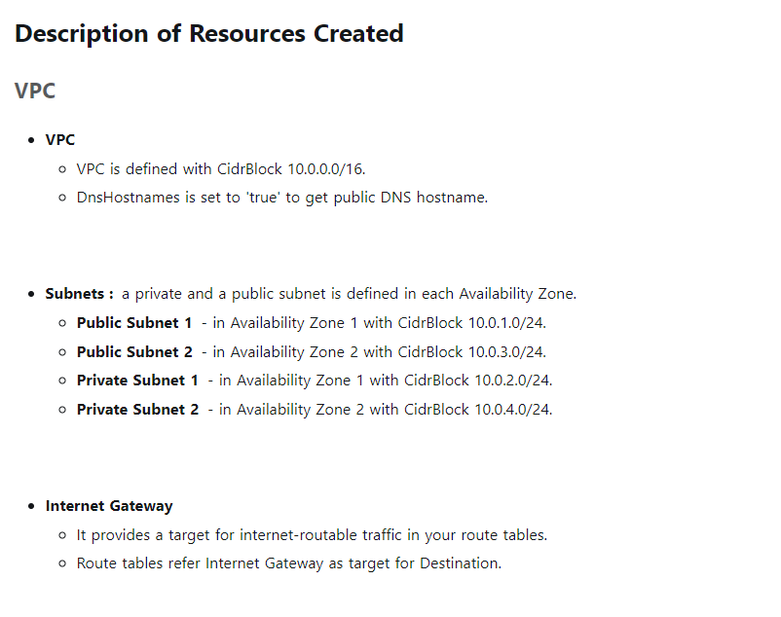

Slide 31
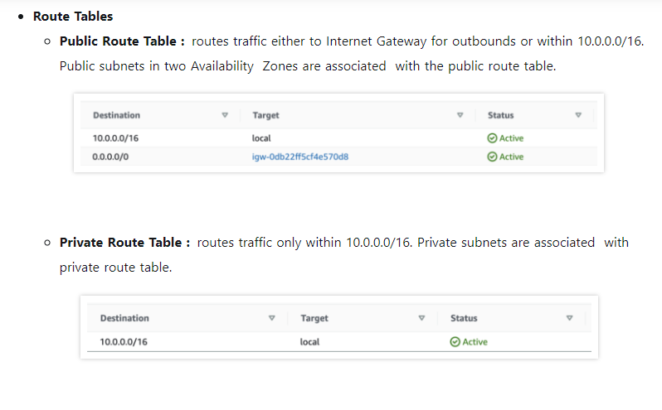

Slide 32
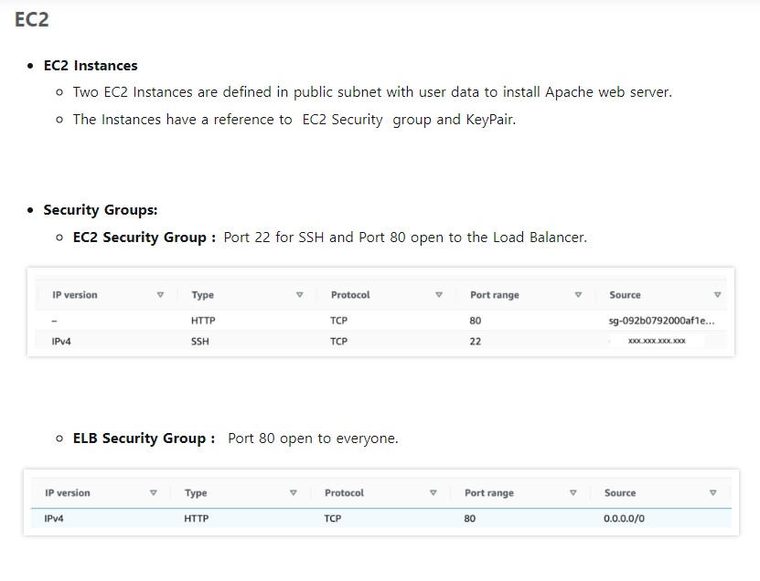

Slide 33
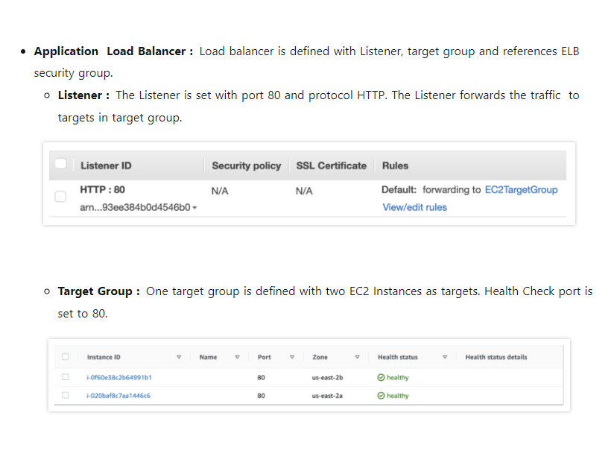

Slide 34
Q&A

